Slide 1
OpenACC
Computer Division
Bhabha Atomic Research Centre

Slide 2
Topics
Computing with Accelerators
Heterogeneous Computing
OpenACC
Development Cycle
Compute Directives
Data Clauses
Vector Addition Example

Slide 3
Computing with Accelerators
CPU | OpenMP | MPI |  | OpenACC | OpenCL
GPU | OpenMP |  | CUDA | OpenACC | OpenCL
DSP |  |  |  | OpenACC | OpenCL
FPGA |  |  |  | OpenACC | OpenCL

Slide 4
Software for Heterogenous Computing
Low Level APIs
CUDA: Specific to Nvidia GPUs
OpenCL: All Accelerators supported, even FPGA
Both are openly available, but one needs to learn new syntax for writing and calling kernel functions
High Level APIs (requires compiler support)
OpenACC: Compiler directive based, user friendly, similar to OpenMP
OpenMP: Ver 4.0 onwards has support for heterogenous archs
Compilers
NVCC and CRAY compilers give Support OpenACC
Intel Compiler gives support through OpenMP
Notes:
HMPP – Hybrid Multicore Parallel Programming
CAPS – Compiler and Architecture for Embedded and Superscalar Processors
Now, GNU Compilers 5.0 onwards also have support for OpenACC like directives in OpenMP for accelerators (OpenMP ver 4.0 onwards)

Slide 5
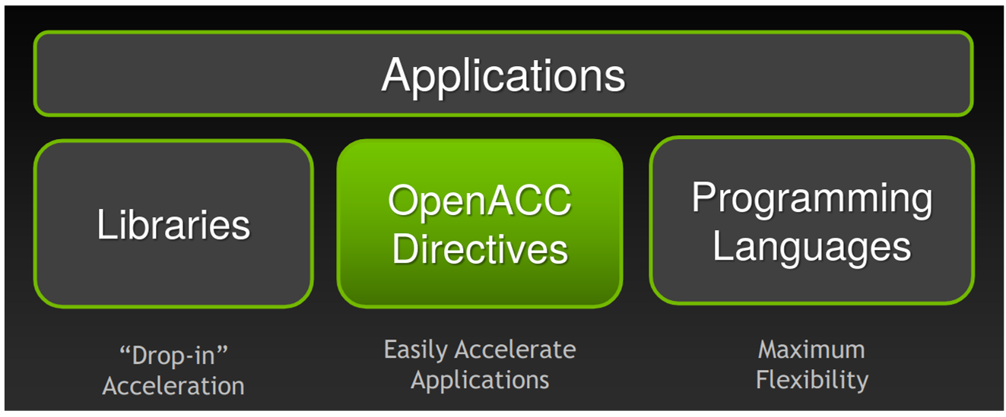
Heterogeneous Computing

Slide 6
Heterogeneous Computing
Libraries
cuBLAS, cuFFT, CUDA Math
Directive based
OpenACC, OpenMP
Programming languages
CUDA – NVIDIA
OpenCL – NVIDIA, ATI, FPGA

Slide 7
OpenACC – Introduction
Supported by
NVIDIA, PGI, GCC, and HPE Gray
Incremental
Single Source
Low Learning Curve

Slide 8
OpenACC – Incremental
Maintain existing sequential code
Add annotations to expose parallelism
Verify correctness
Annotate more code

Slide 9
OpenACC – Incremental
Working sequential code
Parallelization with OpenACC
Verify correctness
Compute performance
/// Sequential code
for( i=0; i <N; i++)
{
c[i] = a[i] + b[i]
}
/// OpenACC code
#pragma acc parallel loop
for( i=0; i <N; i++)
{
c[i] = a[i] + b[i]
}

Slide 10
OpenACC – Single Source
Rebuild same code – Multiple architectures
Compiler based parallelization – Desired machine
Maintained sequential code

Slide 11
OpenACC – Single Source
Supported platforms
POWER, Sunway, x86 CPU, AMD GPU, NVIDIA GPU
Optional OpenACC code additions
Same code for parallel or sequential execution
/// Sequential code
#pragma acc parallel loop
for( i=0; i <N; i++)
{
c[i] = a[i] + b[i]
}
/// OpenACC code
#pragma acc parallel loop
for( i=0; i <N; i++)
{
c[i] = a[i] + b[i]
}

Slide 12
OpenACC – Low Learning Curve
Easy to use
Easy to learn
Programming languages – C, C++, or Fortran
No need to learn low level hardware details

Slide 13
OpenACC – Low Learning Curve
Hints to compiler
Parallelization by compiler
int main(int argc, char *[] argv)
{
/// Sequential code
#pragma acc kernel
for( i=0; i <N; i++)
{
/// Parallel code
}
}

Slide 14
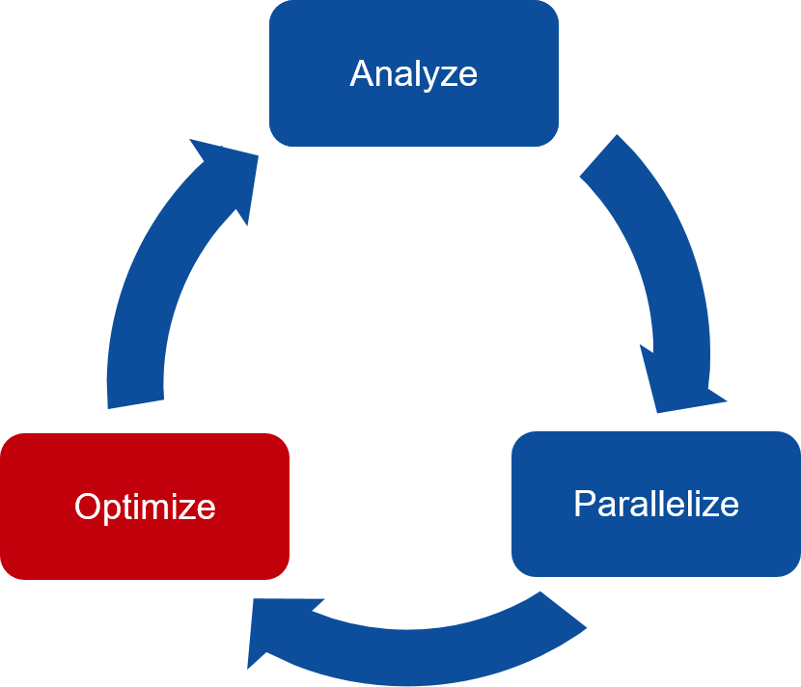
OpenACC Development Cycle
Analyze
Identify code region for parallelization
Parallelize
Parallelize most time consuming part
Check for correctness
Optimize
Improve speed-up

Slide 15
OpenACC Directives
Compute Directives
kernel and parallel
Data Clauses
copy, create, copyin, copyout, delete and present
Loop directives
loop, collapse, gang, worker, vector, and so on
Others
reduction, atomic, cache, and so on

Slide 16
OpenACC Directives – kernels
Automatic parallelization
Hint to compiler
Developer
No parallel programming knowledge
Compiler
Analyze code region
Identify parallelizable loops
Accelerate loops
Portable code
#pragma acc kernels
{
for (i=0; i<N; i++){
y[i] = 0.0f;
x[i] = (float)(i+1);
}
for (i=0; i<N; i++){
y[i] = 2.0f * x[i] + y[i];
}
}

Slide 17
OpenACC Directives – kernels
Two loops
Analyze loops
Check data independence
Parallelize loops
Generate accelerator kernels
Use own knowledge
If not certain
No parallelization
#pragma acc kernels
{
for (i=0; i<N; i++){
y[i] = 0.0f;
x[i] = (float)(i+1);
}
for (i=0; i<N; i++){
y[i] = 2.0f * x[i] + y[i];
}
}

Slide 18
OpenACC Directives – parallel
Use with loop directive
Assertion to compiler
Developer
Identify parallelism
Compiler
Accelerate loops
Portable code
#pragma acc parallel loop
for (i=0; i<N; i++){
y[i] = 0.0f;
x[i] = (float)(i+1);
}
#pragma acc parallel loop
for (i=0; i<N; i++){
y[i] = 2.0f * x[i] + y[i];
}

Slide 19
OpenACC Directives – parallel
Two loops
Each loop – parallel loop directive
Developer
Identify loops
Check data independence
Loop – Safe for parallelization
Compiler
Parallelize loops
Generate accelerator kernels
#pragma acc parallel loop
for (i=0; i<N; i++){
y[i] = 0.0f;
x[i] = (float)(i+1);
}
#pragma acc parallel loop
for (i=0; i<N; i++){
y[i] = 2.0f * x[i] + y[i];
}

Slide 20
kernels v/s parallel
kernels
More implicit
More freedom to compiler
Compiler finds parallelism
Compiler ensures safe parallelism
Compiler maps parallelism
Compiler generates accelerator kernels
parallel
More explicit
Less freedom to compiler
Developer finds parallelism
Developer ensures safe parallelism
Compiler maps parallelism
Compiler generates accelerator kernels

Slide 21
kernels v/s parallel
#pragma acc kernels
{
for (i=0; i<n; i++)
a[i] = 3.0f*(float)(i+1);
for (i=0; i<n; i++)
b[i] = 2.0f*a[i];
}
#pragma acc parallel
{
#pragma acc loop
for (i=0; i<n; i++)
a[i] = 3.0f*(float)(i+1);
#pragma acc loop
for (i=0; i<n; i++)
b[i] = 2.0f*a[i];
}
Generate two kernels
Implicit barrier between loops
Generate one kernel
No barrier between loops

Slide 22
OpenACC – Data Clauses
Additional control over data
How data is created ?
When data is created ?
When data is copied ?
What is source of data ?
Where data is copied ?
Add to
parallel, or kernels directives

Slide 23
OpenACC – Data Clauses
copy
Create space for variables on device
Initialize variables by copying data to device at beginning
Copy results back to host at end
Release space on device when done
copyin
Create space for variables on device
Initialize variables by copying data to device at beginning
Release space on device when done
Do not copy results back to host at end

Slide 24
OpenACC – Data Clauses
copyout
Create space for variables on device
Do not initialize variables at beginning
Copy results back to host at end
Release space on device when done
create
Create space for variables on device
Release space on device when done

Slide 25
OpenACC – Data Clauses
present
List variables already present on device
No further action
Data region at higher level routine

Slide 26
OpenACC – Data Clauses – copy
#pragma acc data copy(a, b, c)
{
#pragma acc parallel
{
#pragma acc loop
for (i = 0; i < N; i++) {
c[i] = a[i] * b[i];
}
}
}
Create space for a, b, c
Copy a, b, c data at beginning
Copy back a, b, c data at end
Release space for a, b, c

Slide 27
OpenACC – Data Clauses – copyin & copyout
Create space for a, b, c
Copy a, b data at beginning
Copy back c data at end
Release space for a, b, c
#pragma acc data copyin(a, b), copyout(c)
{
#pragma acc parallel
{
#pragma acc loop
for (i = 0; i < N; i++) {
c[i] = a[i] * b[i];
}
}
}

Slide 28
OpenACC – Array Shaping
#pragma acc data copy(a[0:N])
{
#pragma acc parallel
{
#pragma acc loop
for (i = 0; i < N; i++) {
a[i] = a[i] * a[i];
}
}
}
Understand shape of array
Start index
Length of data

Slide 29
OpenACC – Vector Addition
#include <stdio.h>
#include <stdlib.h>
#include <math.h>

Slide 30
OpenACC – Vector Addition
int main( int argc, char* argv[] )
{
// Size of vectors
int n = 10000;
// Input vectors
double *restrict a;
double *restrict b;
// Output vector
double *restrict c;

Slide 31
OpenACC – Vector Addition – restrict
Avoid pointer aliasing
During lifetime of pointer, use only
Pointer
Value directly derived from pointer

Slide 32
OpenACC – Vector Addition
// Size, in bytes, of each vector
size_t bytes = n*sizeof(double);
// Allocate memory for each vector
a = (double*)malloc(bytes);
b = (double*)malloc(bytes);
c = (double*)malloc(bytes);

Slide 33
OpenACC – Vector Addition
// Initialize content of input vectors,
// vector a[i] = sin(i)^2
// vector b[i] = cos(i)^2
int i;
for(i=0; i<n; i++) {
a[i] = sin(i)*sin(i);
b[i] = cos(i)*cos(i);
}

Slide 34
OpenACC – Vector Addition
// Sum component wise vector a and vector b
// Save result into vector c
#pragma acc kernels copyin(a[0:n],b[0:n]), copyout(c[0:n])
for(i=0; i<n; i++) {
c[i] = a[i] + b[i];
}

Slide 35
OpenACC – Vector Addition
// Sum up vector c
// Print result divided by n
// This should equal 1 within error
double sum = 0.0;
for(i=0; i<n; i++) {
sum += c[i];
}
sum = sum/n;
Printf(“final result: %f\n”, sum);

Slide 36
OpenACC – Vector Addition
// Release memory
free(a);
free(b);
free(c);
return(0);
}

Slide 37
Questions?
Thank you

